Slide 1
EVADC Timing 19 May 2021
C_PMC_11F/5.1/27-Feb-19

Slide 2
ADC signal Details
AFC | DABP | DABS | Control Board
VAC1_SNS_PM1IN | VAC1_SNS_PM2IN | VAC1_SNS_PM3IN | AMB_SENSE_1
VAC2_SNS_PM1IN | VAC2_SNS_PM2IN | VAC2_SNS_PM3IN | AMB_SENSE_2
VAC3_SNS_PM1IN | VAC3_SNS_PM2IN | VAC3_SNS_PM3IN
VDC_SNS_PM1IN | VDC_SNS_PM2IN | ILEG1_SNS_PM3IN
IPH1_SNS_PM1IN | ILEG1_SNS_PM2IN | ILEG2_SNS_PM3IN
IPH2_SNS_PM1IN | ILEG2_SNS_PM2IN | ILEG3_SNS_PM3IN
IPH3_SNS_PM1IN | ILEG3_SNS_PM2IN | IPH1_SNS_PM3IN
ILEG1_SNS_PM1IN | IPH1_SNS_PM2IN | IPH2_SNS_PM3IN
ILEG2_SNS_PM1IN | IPH2_SNS_PM2IN | IPH3_SNS_PM3IN
ILEG3_SNS_PM1IN | IPH3_SNS_PM2IN | TEMP_HS_SNS_PM3IN
TEMP_HS_SNS_PM1IN | TEMP_HS_SNS_PM2IN | TEMP_PCB_SNS_PM3IN
TEMP_PCB_SNS_PM1IN | TEMP_PCB_SNS_PM2IN | TEMP_LEG1_SNS_PM3IN
TEMP_LEG1_SNS_PM1IN | TEMP_LEG1_SNS_PM2IN | TEMP_LEG2_SNS_PM3IN
TEMP_LEG2_SNS_PM1IN | TEMP_LEG2_SNS_PM2IN | TEMP_LEG3_SNS_PM3IN
TEMP_LEG3_SNS_PM1IN | TEMP_LEG3_SNS_PM2IN | 24V_SNS_PM3IN
24V_SNS_PM1IN | 24V_SNS_PM2IN | VDC_SNS_PM3IN
 |  | CUR_SNS
Total count 51

Slide 3
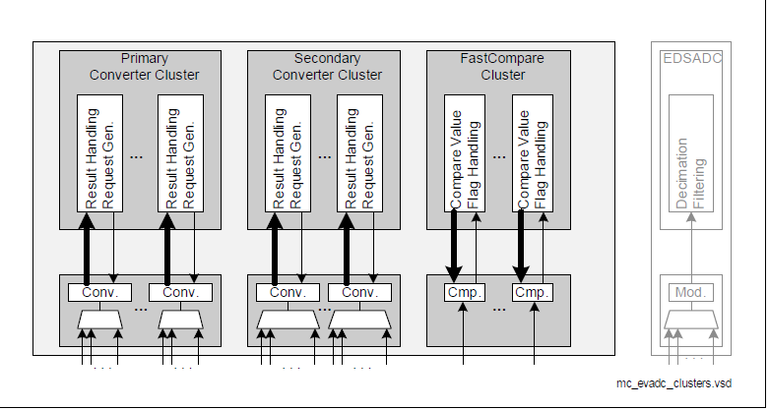
Primary converter cluster - 8 Stage queue - conversion time below 0.5us
Secondary Converter cluster– 16 stage queue – conversion time below 1us
Each group has individual converter, it will work concurrently
8 groups in Tc377 ( 8 converters for each Group)

Slide 4
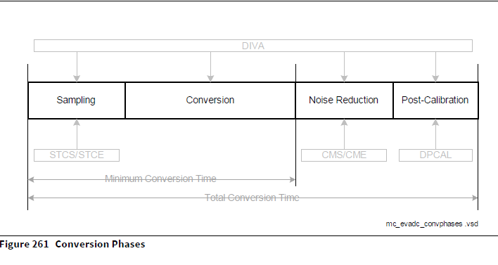
ADC Maximum frequency 20Mhz
Sample time minimum 100ns
Result generation time 650ns
Minimum time of conversion without post calibration is 768.75ns (single channel)

Slide 5
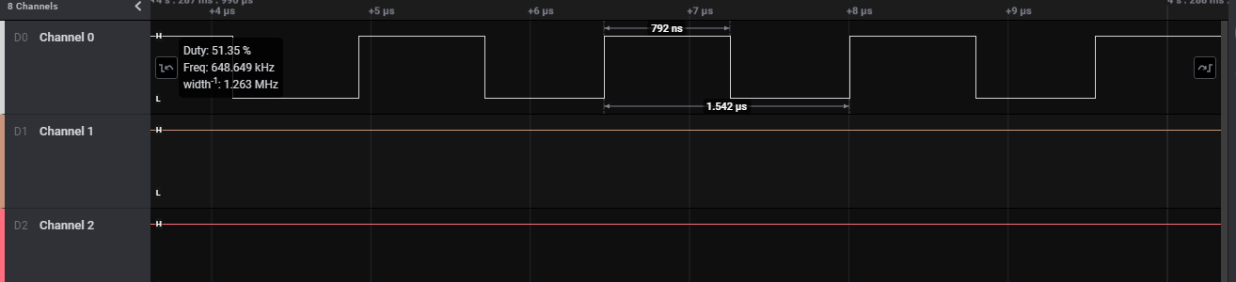
Sample time 100ns – primary channel
Each conversion to result generation takes 792ns for single channel

Slide 6
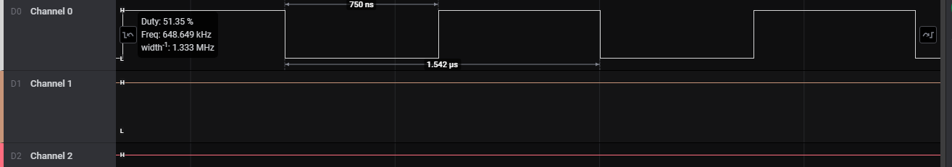
Sample time 100ns – secondary cluster Channel
Each conversion to result generation takes 750ns for single channel

Slide 7
Each group has 3 queue with respective stages
Using that queue we can configure the priority of the channel
ADC has 4 priority (highest, high, low, lowest)
Group 0 and Group 1 converter dedicated to closed loop
Sample Timing of 500ns
Every 5.2us all 7 channel will get converted
Closed Loop Channel
Group 0 | Group 1
VAC1_SNS_PM1IN | IPH1_SNS_PM1IN
VAC2_SNS_PM1IN | IPH2_SNS_PM1IN
VAC3_SNS_PM1IN | IPH3_SNS_PM1IN
 | VDC_SNS_PM3IN

Slide 8
Remaining Channel in current pin mapping
Configure the channel priority to reduce the conversion timing
Group 8 | Group 9 | Group 11 | Group 3
TEMP_PCB_SNS_PM1IN | IPH1_SNS_PM2IN | ILEG1_SNS_PM1IN | AMB_SENSE_1
TEMP_LEG1_SNS_PM1IN | IPH2_SNS_PM2IN | ILEG2_SNS_PM1IN | 1
TEMP_LEG2_SNS_PM1IN | IPH3_SNS_PM2IN | ILEG3_SNS_PM1IN
TEMP_LEG3_SNS_PM1IN | TEMP_HS_SNS_PM2IN | TEMP_HS_SNS_PM1IN
24V_SNS_PM1IN | TEMP_PCB_SNS_PM2IN | ILEG1_SNS_PM3IN
VAC1_SNS_PM2IN | TEMP_LEG1_SNS_PM2IN | ILEG2_SNS_PM3IN
VAC2_SNS_PM2IN | TEMP_LEG2_SNS_PM2IN | ILEG3_SNS_PM3IN
VAC3_SNS_PM2IN | TEMP_LEG3_SNS_PM2IN | IPH1_SNS_PM3IN
VDC_SNS_PM2IN | 24V_SNS_PM2IN | IPH2_SNS_PM3IN
ILEG1_SNS_PM2IN | VAC1_SNS_PM3IN | IPH3_SNS_PM3IN
ILEG2_SNS_PM2IN | VAC2_SNS_PM3IN | TEMP_HS_SNS_PM3IN
ILEG3_SNS_PM2IN | VAC3_SNS_PM3IN | TEMP_PCB_SNS_PM3IN
12 | AMB_SENSE_2 | TEMP_LEG1_SNS_PM3IN
 | CUR_SNS | TEMP_LEG2_SNS_PM3IN
 | 14 | TEMP_LEG3_SNS_PM3IN
 |  | 24V_SNS_PM3IN
 |  | 16
We can configure either G11 or G2,G3

Slide 9
Low Priority
TEMP_HS_SNS_PM1IN
TEMP_PCB_SNS_PM1IN
TEMP_LEG1_SNS_PM1IN
TEMP_LEG2_SNS_PM1IN
TEMP_LEG3_SNS_PM1IN
TEMP_HS_SNS_PM2IN
TEMP_PCB_SNS_PM2IN
TEMP_LEG1_SNS_PM2IN
TEMP_LEG2_SNS_PM2IN
TEMP_LEG3_SNS_PM2IN
TEMP_HS_SNS_PM3IN
TEMP_PCB_SNS_PM3IN
TEMP_LEG1_SNS_PM3IN
TEMP_LEG2_SNS_PM3IN
TEMP_LEG3_SNS_PM3IN
AMB_SENSE_1
AMB_SENSE_2
Medium Priority
24V_SNS_PM1IN
24V_SNS_PM2IN
24V_SNS_PM3IN
VAC1_SNS_PM3IN
VAC2_SNS_PM3IN
VAC3_SNS_PM3IN
CUR_SNS
Temperature rising will happen slowly and Voltage to be scan every 4 cycle of High priority channel scanning
The Low priority Channel will get converted once in every 1sec
Using Priority we can reduce channel which saves the scanning time

Slide 10
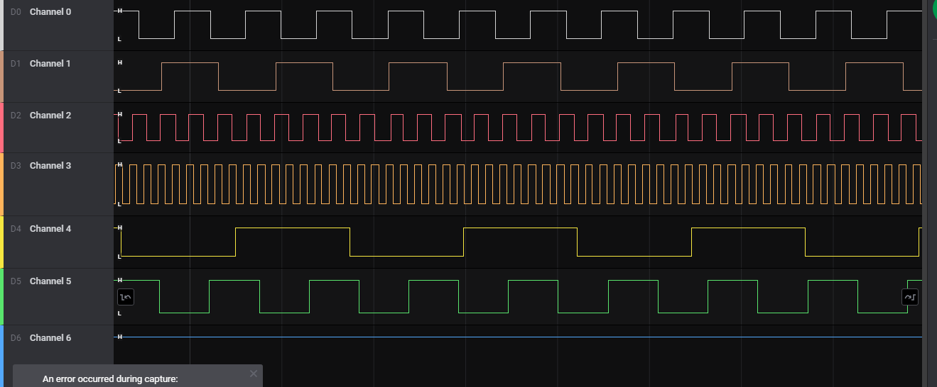
Sample time - 100ns
Ch 0 – 5 channel configuration – 3.917us
Ch 1 – 8 channel configuration – 6.25us
Ch 2 – 2 channel configuration – 1.583us
Ch3 – 1 channel configuration – 792ns
Ch4 – 16 channel configuration – 12.417us
Ch5 – 8 channel sec configuration – 5.6us
Sample time - 500ns
Ch 0 – 5 channel configuration – 5.917us
Ch 1 – 8 channel configuration – 9.417us
Ch 2 – 2 channel configuration – 2.375us
Ch3 – 1 channel configuration – 1.167us
Ch4 – 16 channel configuration – 18.833us
Ch5 – 8 channel sec configuration – 9.417us

Slide 11
Volt Sec balance in Current Pin Mapping
Group 8
TEMP_PCB_SNS_PM1IN
TEMP_LEG1_SNS_PM1IN
TEMP_LEG2_SNS_PM1IN
TEMP_LEG3_SNS_PM1IN
24V_SNS_PM1IN
VAC1_SNS_PM2IN
VAC2_SNS_PM2IN
VAC3_SNS_PM2IN
VDC_SNS_PM2IN
ILEG1_SNS_PM2IN
ILEG2_SNS_PM2IN
ILEG3_SNS_PM2IN
Converter scan starts 1s once
All channel conversion ends in 9.5us in case of 100ns sample time without any additional feature (post calibration, noise reduction and broken wire)
Without Temperature channels then timing of conversion will be 6.3us
For sampling time 500ns the conversion timing will be 10.4us without Temp channels and 15.6us with Temp channels

Slide 12
Continuous scanning of Volt sec Bal Channels
Conversion Timing will be 2.3us for 100ns samping rate and 3.9us for 500ns sampling rate
Leg current sensing will get affected.
Group 8
TEMP_PCB_SNS_PM1IN
TEMP_LEG1_SNS_PM1IN
TEMP_LEG2_SNS_PM1IN
TEMP_LEG3_SNS_PM1IN
24V_SNS_PM1IN
VAC1_SNS_PM2IN
VAC2_SNS_PM2IN
VAC3_SNS_PM2IN
VDC_SNS_PM2IN
ILEG1_SNS_PM2IN
ILEG2_SNS_PM2IN
ILEG3_SNS_PM2IN
Converter scan starts 1s once
Conversion starts once in 10 cycle of ac voltage

Slide 13
Group 0 | Group 1 | Group 2 | Group 3 | Group 8 | Group 9 | Group 10 | Group 11
4 | 4 | Not Using | 1 | 12 | 14 | Not using | 16
Other approach
Group 8 | Group 9 | Group 11 | Group 3
TEMP_PCB_SNS_PM1IN | IPH1_SNS_PM2IN | ILEG1_SNS_PM1IN | AMB_SENSE_1
TEMP_LEG1_SNS_PM1IN | IPH2_SNS_PM2IN | ILEG2_SNS_PM1IN | 1
TEMP_LEG2_SNS_PM1IN | IPH3_SNS_PM2IN | ILEG3_SNS_PM1IN
TEMP_LEG3_SNS_PM1IN | TEMP_HS_SNS_PM2IN | TEMP_HS_SNS_PM1IN
24V_SNS_PM1IN | TEMP_PCB_SNS_PM2IN | ILEG1_SNS_PM3IN
VAC1_SNS_PM2IN | TEMP_LEG1_SNS_PM2IN | ILEG2_SNS_PM3IN
VAC2_SNS_PM2IN | TEMP_LEG2_SNS_PM2IN | ILEG3_SNS_PM3IN
VAC3_SNS_PM2IN | TEMP_LEG3_SNS_PM2IN | IPH1_SNS_PM3IN
VDC_SNS_PM2IN | 24V_SNS_PM2IN | IPH2_SNS_PM3IN
ILEG1_SNS_PM2IN | VAC1_SNS_PM3IN | IPH3_SNS_PM3IN
ILEG2_SNS_PM2IN | VAC2_SNS_PM3IN | TEMP_HS_SNS_PM3IN
ILEG3_SNS_PM2IN | VAC3_SNS_PM3IN | TEMP_PCB_SNS_PM3IN
12 | AMB_SENSE_2 | TEMP_LEG1_SNS_PM3IN
 | CUR_SNS | TEMP_LEG2_SNS_PM3IN
 | 14 | TEMP_LEG3_SNS_PM3IN
 |  | 24V_SNS_PM3IN
 |  | 16
We can configure either G11 or G2,G3
Remapping the Volt sec bal channel to G2,G3,G10 (single channel each)
For sampling time of 100ns all 3 channel will get converted in 792ns and for 500ns result will get in 1.3us

Slide 14
Other approach
4 Fast compare channel in Tc377
Comparing time will be 218 ns
We can use this features to scan the leg current to protect the mosfet
9 leg current sensing pin in All 3 board
EVADC_FC2CH0 | Group9Ch0 | P00.12 | IPH1_SNS_PM2IN
EVADC_FC3CH0 | Group9Ch1 | P00.11 | IPH2_SNS_PM2IN
EVADC_FC0CH0 | Group2Ch0 | AN16 | 3V3_SNS_ANG2_PM3IN
EVADC_FC1CH0 | Group2Ch1 | AN17 | SNS_SPARE4IN

Slide 15
THANK YOU
C_PMC_11F/5.1/27-Feb-19

